Slide 1
Middleware

Slide 2
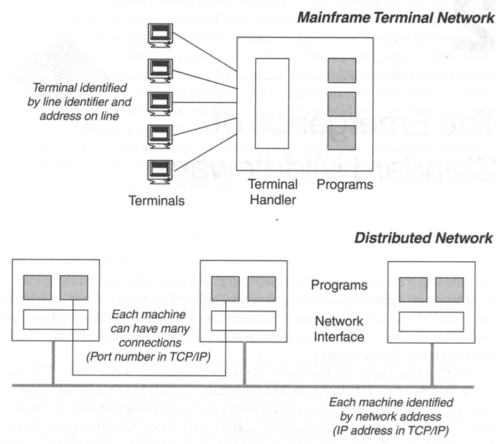
History
Notes:
Most people today take “networks” for granted. At one point in time it was not exactly intuitive to connect one or more computers together!
First distributed system appeared in 1969 when DARPA created a 4 node network known as ARPANET, which grew to 50 computers by 1972 (universities and gov research labs.)
Early on “networking” meant “dump” terminals attached to mainframes. However, once the PC emerged in the latest 70s, early 80s terminals started getting replaced with PCs.
Middleware first existed to address a need in certain vertical industries. Good examples of this are in the banking industry and the airline industry.
Tech companies started to build out proprietary solutions for this business need:
IBM – SNA, Sperry – DCA, Burroughs – DNA, DEC – DNA
These solutions typically provided File xfer, remote printing, terminal transfer, etc. They were NOT open, so you were locked into a single vendor.

Slide 3
The computing revolution
Two important technological advances that accelerated the computing industry
Powerful microprocessor technologies
High speed computer networks
LANs
WANs
Notes:
From a machine that costs $1M and executed 1 instruction per second, now we have machines that cost < $1k that execute > 1B instructions per second. Price performance gain of 10^13. e.g. a Rolls Royce would cost $1 and get a billion miles per gallon (and a 200 page manual telling how to open the door)

Slide 4
The rise of heterogeneity
Computing became a very profitable (and competitive) industry
Initially, proprietary software/hardware was strategic…
Eventually, organizations started to put pressure on vendors to standardize

Slide 5
Standards: dealing with heterogeneity
Standard Programming Languages
E.g. COBOL, C
Standards Interfaces (e.g. databases)
SQL, ODBC
Standard Protocols
FTP, RPC

Slide 6
Middleware objectives
Hide heterogeneity
Location independence
Common functionality needed by many applications
Software portability
Help integrate legacy facilities
Aid application interoperability
Aid scalability

Slide 7
The new infrastructure
Middleware is
where new capabilities are added by layering
where much of the experimentation and innovation happens in the infrastructure
where the successful approaches have a chance to become a spanning layer and/or integrated into a distributed OS
Boundary to a distributed OS is fuzzy

Slide 8
What is Middleware?
Layer between OS and distributed applications
Hides complexity and heterogeneity of distributed system
Bridges gap between low-level OS communications and programming language abstractions
Provides common programming abstraction and infrastructure for distributed applications
Distributed Applications
Distributed Applications
Distributed Applications
Middleware
(remote calls, object invocation, messages, …)
Operating System Comms
Operating System Comms
Operating System Comms
(sockets, IP, TCP, UDP, …)
Network
Network
Network
(packets, bits…)

Slide 9
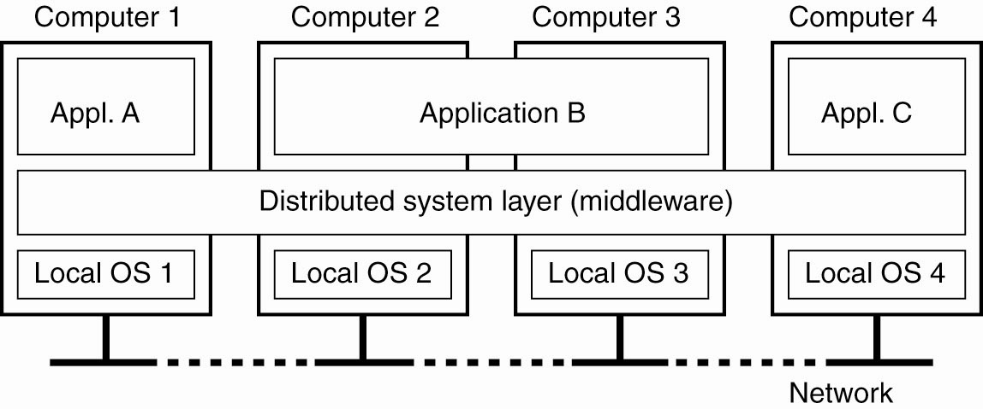
Distributed systems organized as middleware
The middleware layer extends over multiple machines and offers each application the same interface.
Notes:
The computers and networks are heterogeneous. A layer of software commonly referred to as middleware shields the applications from the differences.
Goals of Distributed Systems – What are we trying to achieve?
Making resources accessible
Distribution transparency
Openness
Scalability

Slide 10
Discussion
Based on what you have learned so far, do you think middleware is a software or a hardware?
Please go to
PollEv.com/cisgvsu429

Slide 11
Example: Communication Middleware
Application
Application
Middleware
Middleware
Network Protocol Stack
Network Protocol Stack

Slide 12
Support and dimensions
Middleware provides support for (some of):
Naming, Location, Service discovery, Replication
Protocol handling, Communication faults, QoS
Synchronisation, Concurrency, Transactions, Storage
Access control, Authentication
Middleware dimensions:
Request/Reply vs. Asynchronous Messaging
Language-specific vs. Language-independent
Proprietary vs. Standards-based
Small-scale vs. Large-scale
Tightly-coupled vs. Loosely-coupled components

Slide 13
Middleware Characteristics
Meets the needs of a wide variety of applications across many industries
Cross platform
Distributed
Ideally, supports standard protocols
Supports standard APIs

Slide 14
Categories of services
Data Management Services (e.g., Database and file system middleware).
Communication Services (e.g., RPC (Remote Procedure Call)
Messaging middleware (e.g., web service)
Distribution Services (e.g., location, time and security services).
Object-oriented Services (e.g., Java RMI)
Application Co-operation Services (e.g., Transaction-Processing (TP) monitors, e-mail, etc.).
Presentation Services (e.g., User Interfaces, printing and multi-media middleware).
System Management Services (e.g., Configuration, change, operations, and performance management services)

Slide 15
Summary
Middleware makes it easier to build distributed applications: hides heterogeneity.
There are different flavors of middleware, each has its own strengths for certain situation.
Notes:
`

